Slide 1
Laplace Transform

Slide 2
Introduction
A Transformation is an operation which converts a mathematical expression to a different but equivalent form.
An integral transform maps an equation from its original domain into another domain where it might be manipulated and solved much more easily than in the original domain. The solution is then mapped back to the original domain using the inverse of the integral transform.

Slide 3
As an example of an application of integral transforms, consider the Laplace transform.
Laplace transform is a technique for solving differential equations. Here differential equation of time domain form is first transformed to algebraic equation of frequency domain form. After solving the algebraic equation in frequency domain, the result then is finally transformed to time domain form to achieve the ultimate solution of the differential equation.

Slide 4
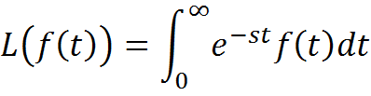
Definition of Laplace transform:
The Laplace transform of a function f(t), defined for all real numbers t ≥ 0, is the function F(s), which is a unilateral transform defined by
Here s is the parameter which is either real or complex; L is the Laplace transform operator.

Slide 5

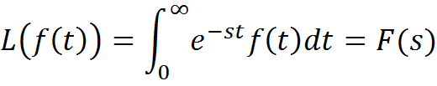
Note that is a function of both s and t, but when this integrated with respect to t and the limits are applied, then the resulting function is always function of s. Hence we always write L(f(t))=F(s) . Thus,

Slide 6
Condition for existence of Laplace transform
We give sufficient condition for the existence of Laplace transform. We need the concept of piecewise continuous function.
1. A function f is piecewise continuous on the interval [a, b] if (i) The interval [a, b] can be broken into a finite number of subintervals
a = t0 < t1 < t2 < · · · < tn = b, such that f is continuous in each subinterval (ti, ti+1), for
i = 0, 1, 2, · · · , n − 1.

Slide 7
2. f(t) should be of exponential order.
As an example, L(tan t) does not exist since tan t is not piecewise continuous. i.e., tant has infinite number of infinite.

Slide 8
Laplace transform of standard functions
1.
2.
3.
4.

Slide 9
5.
6.
where n is nonnegative real number or negative fraction.

Slide 10
When n is a positive integer,

Slide 11
Properties of Laplace transform
Linearity property: Let f(t) and g(t) be any two functions and a and b be any two constants, then
Change of scale property: If If L(f(t))=F(s),
then

Slide 12
The following properties are useful in obtaining the Laplace transform of product and quotient of two or more functions.
3. Multiplication by : If L(f(t))=F(s), then
Note: If If L(f(t))=F(s), then

Slide 13
4. Multiplication by : If L(f(t))=F(s), then
5. Division by t: If L(f(t))=F(s), then
provided

Slide 14
6. Transform of integrals: If L(f(t))=F(s), then
Generalization:

Slide 15
Periodic function
A function is said to be periodic (or, when emphasizing the presence of a single period instead of multiple periods, singly periodic) with period if f(x)=f(x+np) for n=1,2,…
The constant function is periodic with any period for all nonzero real numbers, so there is no concept analogous to the least period for constant functions.

Slide 16
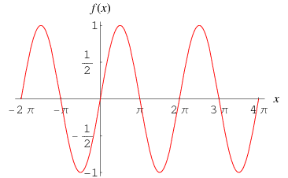

Slide 17
For example, the sine function, illustrated, is periodic with least period (often simply called "the“ period) (as well as with period 2π, 4π ,6π , etc.).
Periodic functions are used throughout science to describe oscillations, waves, and other phenomena that exhibit periodicity. Any function that is not periodic is called aperiodic.

Slide 18
Laplace transform of periodic functions
Theorem: If f(t) is a periodic function with period T, then

Slide 19
Unit impulse function (Dirac Delta function)
The unit impulse function denoted by
is defined as the limiting form of as
. That is, , where
a is nonnegative constant.

Slide 20
The laplace transform of unit impulse function
is
In particular,

Slide 21
Unit step function (Heaviside Unit function)
The unit step function denoted by u(t-a) is
defined by, where a is
nonnegative constant.
It is used to find the Laplace transform of discontinuous function.

Slide 22
In particular, when a=0,
The Laplace transform of unit step function u(t-a)
is
In particular,

Slide 23
Heaviside Shift Theorem: If L(f(t))=F(s), then

